Slide 1



Airline Product Management Working Group
From Model to shared Product
Objectives, Requirements and Key Success Factors
Call 25/05/2023 / G. Baues AirFrance/KLM

Slide 2
Table of contents
01
02
03
04
05
06
Introduction
Objectives
Meta
Seat
Outlook
Proposal

Slide 3
Introduction
The airline industry is shifting to a modern retailing environment and setup which entails fundamental changes in how we organize B2B relations in our industry and beyond.
As Airlines we want to be able to share and consume, within a given framework, each others’ products in order to respond with the best possible offer to our customers
As Airlines we want to be able to integrate content from suppliers outside of our industry transparently within our offers
Notes:
Definitions:
Product Catalogue means an electronic record of the Products and Services that an enterprise is able to sell to a buyer.
Supplier Catalogue means an electronic record of the Products and Services that Supplier has chosen to make available for sale by the Retailer, including any specified general sales conditions
Product and Services as a collective term, means those items which will be delivered to a Customer by the Supplier and consumed as part of their end-to-end travel experience.
products and services will be delivered to the consumer which may also be the customer as of our own definitions

Slide 4
Definitions
Product management is an organizational function that aims to maximize the value of a product by optimizing every step of the product lifecycle.
The Supplier Catalog as well as the Airline Profile are derivates of the Airline Catalog
Airline Catalog
Supplier Catalog
Airline Profile
Is a list of services or items (products) that might be offered by an airline. The depth of detail provided in the catalogue, depends on each individual airline’s requirements, and use cases.
Is a list of services or items (products) that a Supplier has chosen to make available for sale by the Airline Retailer. The content available in the catalogue, depends on the bilateral agreements (SRSIA and other partners).
Is a list of Itineraries (origin, destination) an Airline, as a retailer, makes available to a Seller
Notes:
including but not limited to information about where the products & services are available (i.e., location, market, schedules, miscellaneous information, etc.) and any specified general
Product management is an organizational function that aims to maximize the value of a product by optimizing every step of the product lifecycle.
The intent of an airline profile is to reduce the #calls to the retailer

Slide 5
Objectives
Describe & Specify product management-related Business Capabilities, Requirements and Principles within the scope of B2B product information interactions between airlines and their partners.
Thus, enabling a standardized, unambiguous definition for product information and their exchange.
Output
Outcome

Slide 6
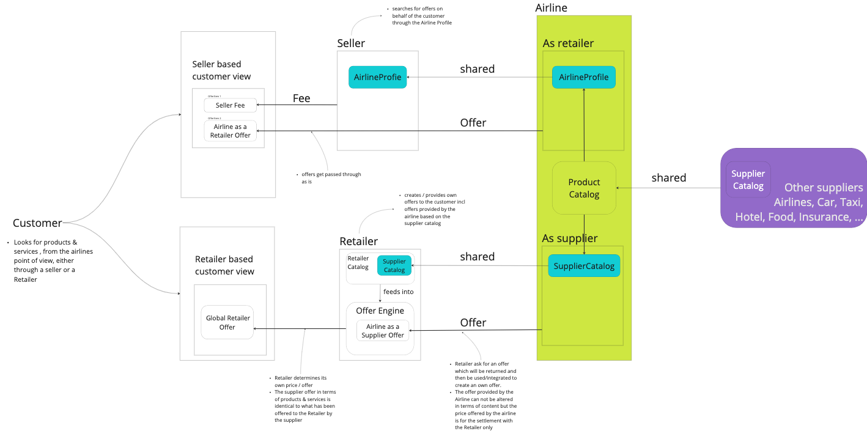
Interactions
To be updated
NDC
NDC
NDC

Slide 7
Intent: utterly incomplete list of user stories
To be completed
As an/a <Role> | I want | so that | Theme
Airline - Retailer | the latest up to date detailed product information available from my suppliers ( shape / form / conditions / ... full list to be determined ) | I can propose the most relevant and accurate offers to my customers and have my offer engine use the avaialble data without any restriction | User Experience / Inspiration / Aquisition #existing products
Airline - Retailer | to propose the best shopping expirience to my customers | Customers can easily find detailed product information about each product, including specifications, features, and benefits. This can help anyone to make an informed purchasing decision.
Customer | to do easy multi criteria search based shopping. Text based search would be perfect | I get the most relevant offers rapidly
Airline - Retailer | up to date information about product delivery for orders i placed with my supplier | I can react accordingly in case of issues with the delivery
Airline - Retailer | to be able to transparently exchange product configuration information with the supplier and vice versa | to honor specific agreement / products as defined in the mutual agreements | #new products #extensibility
Airline - Retailer | to be in control of the information provided by a supplier catalog | only the important / pertinent information is present for creating offers thus optimizing my ressource consumption | #extensibility #optional/mandatory #schema repository / management
Airline - Supplier | to provide the most upto date and complete product information to my retailers within an bilaterally agreed scope | the call rate for offers will be optimized and therefore the conversion rate shall increase | #Traffic #Conversion

Slide 8
Principles
Specify << Product Management >> related Business Capabilities and Requirements and base Principles
List add here some Key Principles from the Principles documents / To be done

Slide 9
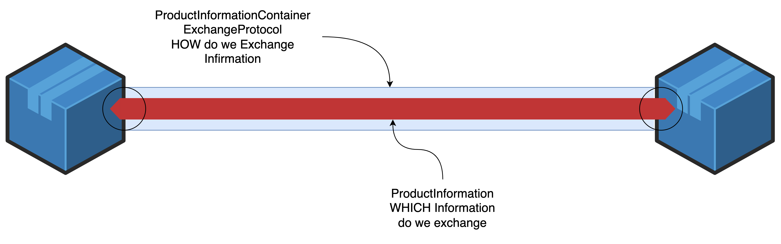
Simplified Problem Statement
CONTENT
Airline A
Retailer(Buyer)
Airline B / Partner
Supplier
CONTAINER
Note: We do not imply ANY concrete implementation type of the exchange here. The only business requirement is that everyone in the exchange understands the ‘language’ in an unambiguous way
Receiver/Sender Interface
speak the same language to understand each other

Slide 10
All of the above, as a common denominator, requires an unambiguous and extensible model allowing to describe the meaning of the products shared.

Slide 11
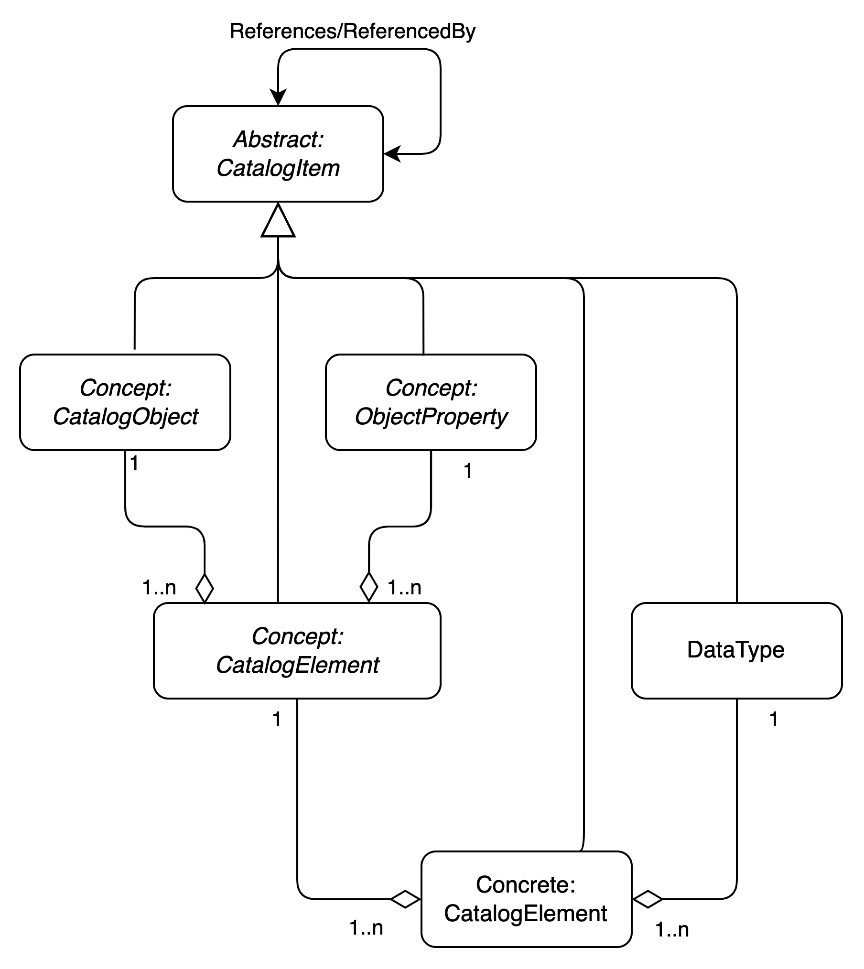
Meta
Metamodel for a Product Catalog ( Structure plus Content )
This model allows to express of all structural components of a catalog including the ones which represent the products shared
It does not define the concrete elements though
This model formalizes/demonstrates the requirement for flexibility/extensibility we look for allowing for bilateral as well as private extensions.

Slide 12
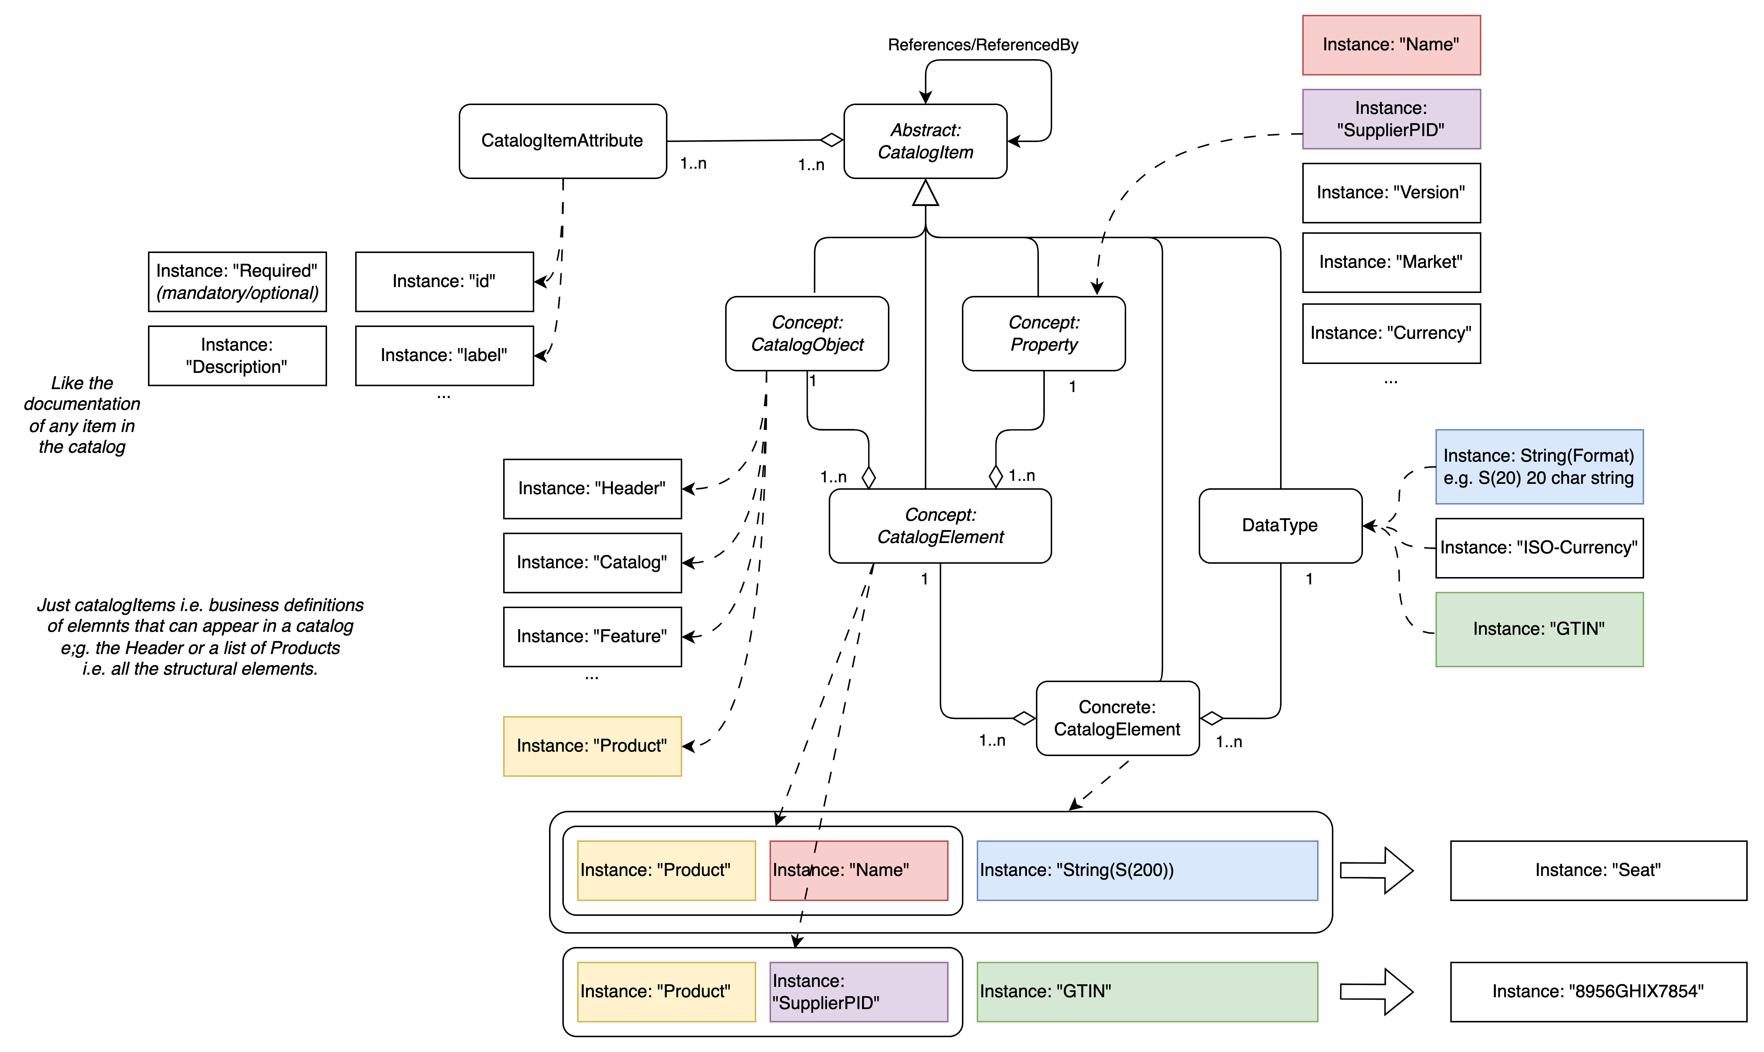
Properties of the Structure Elements
Catalog Structure Elements
Representations of the Structure Elements

Slide 13
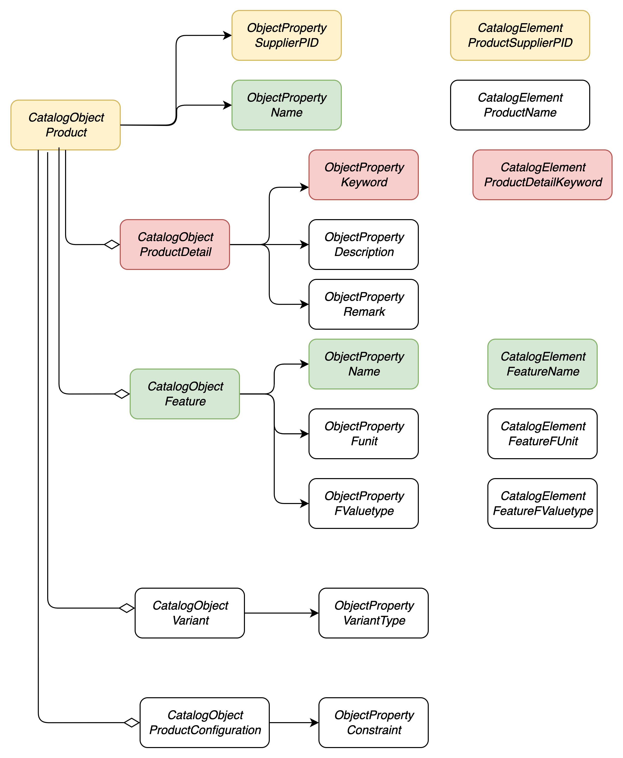
Product
Model for a Product : just for illustration to demonstrate the requirement

Slide 14
Product
Model for a Product : just for illustration to demonstrate the requirement for
ProductDetail :
Desciptions:
Class : CabinClassifier
Keywords:
ProductIdentifiers other : e.g GTIN
IATA Taxonomy: XYZ
Status information : new, updated, deprecated etc ...
Manufacturer
etc etc ...

Slide 15
Product
Model for a Product : just for illustration to demonstrate the requirement for
Features
Recline: Degrees
Adjustable Headrest: yes/no #of positions
Armrests: Sides: left / right / both ; adjustable / foldable
Seat Pitch: length in metric / imperial units
Seat Width: calculation rule (from where to where) :
length in metric/imperial units
Lumbar Support: yes/no #of positions
Adjustable Seat Cushions: yes/no
Footrests: yes/no
Privacy Dividers: yes/no
In-seat Power Outlets:
yes/no, types 220/110V USB / socket type ( Schuko, US, .... )
In-flight Entertainment (IFE) Systems
Reading Lights: yes/no
Tray Tables: yes/no
Overhead Storage Compartments: yes/no volume available etc
Seatback Pockets: yes/no
what reading material is provided for free if any
Seat Material used: leather, tissue, etc ...
SeatNumber : Alphanumeric code ( Row + Postion)
SeatPosition : Window, Ailes, etc ...

Slide 16
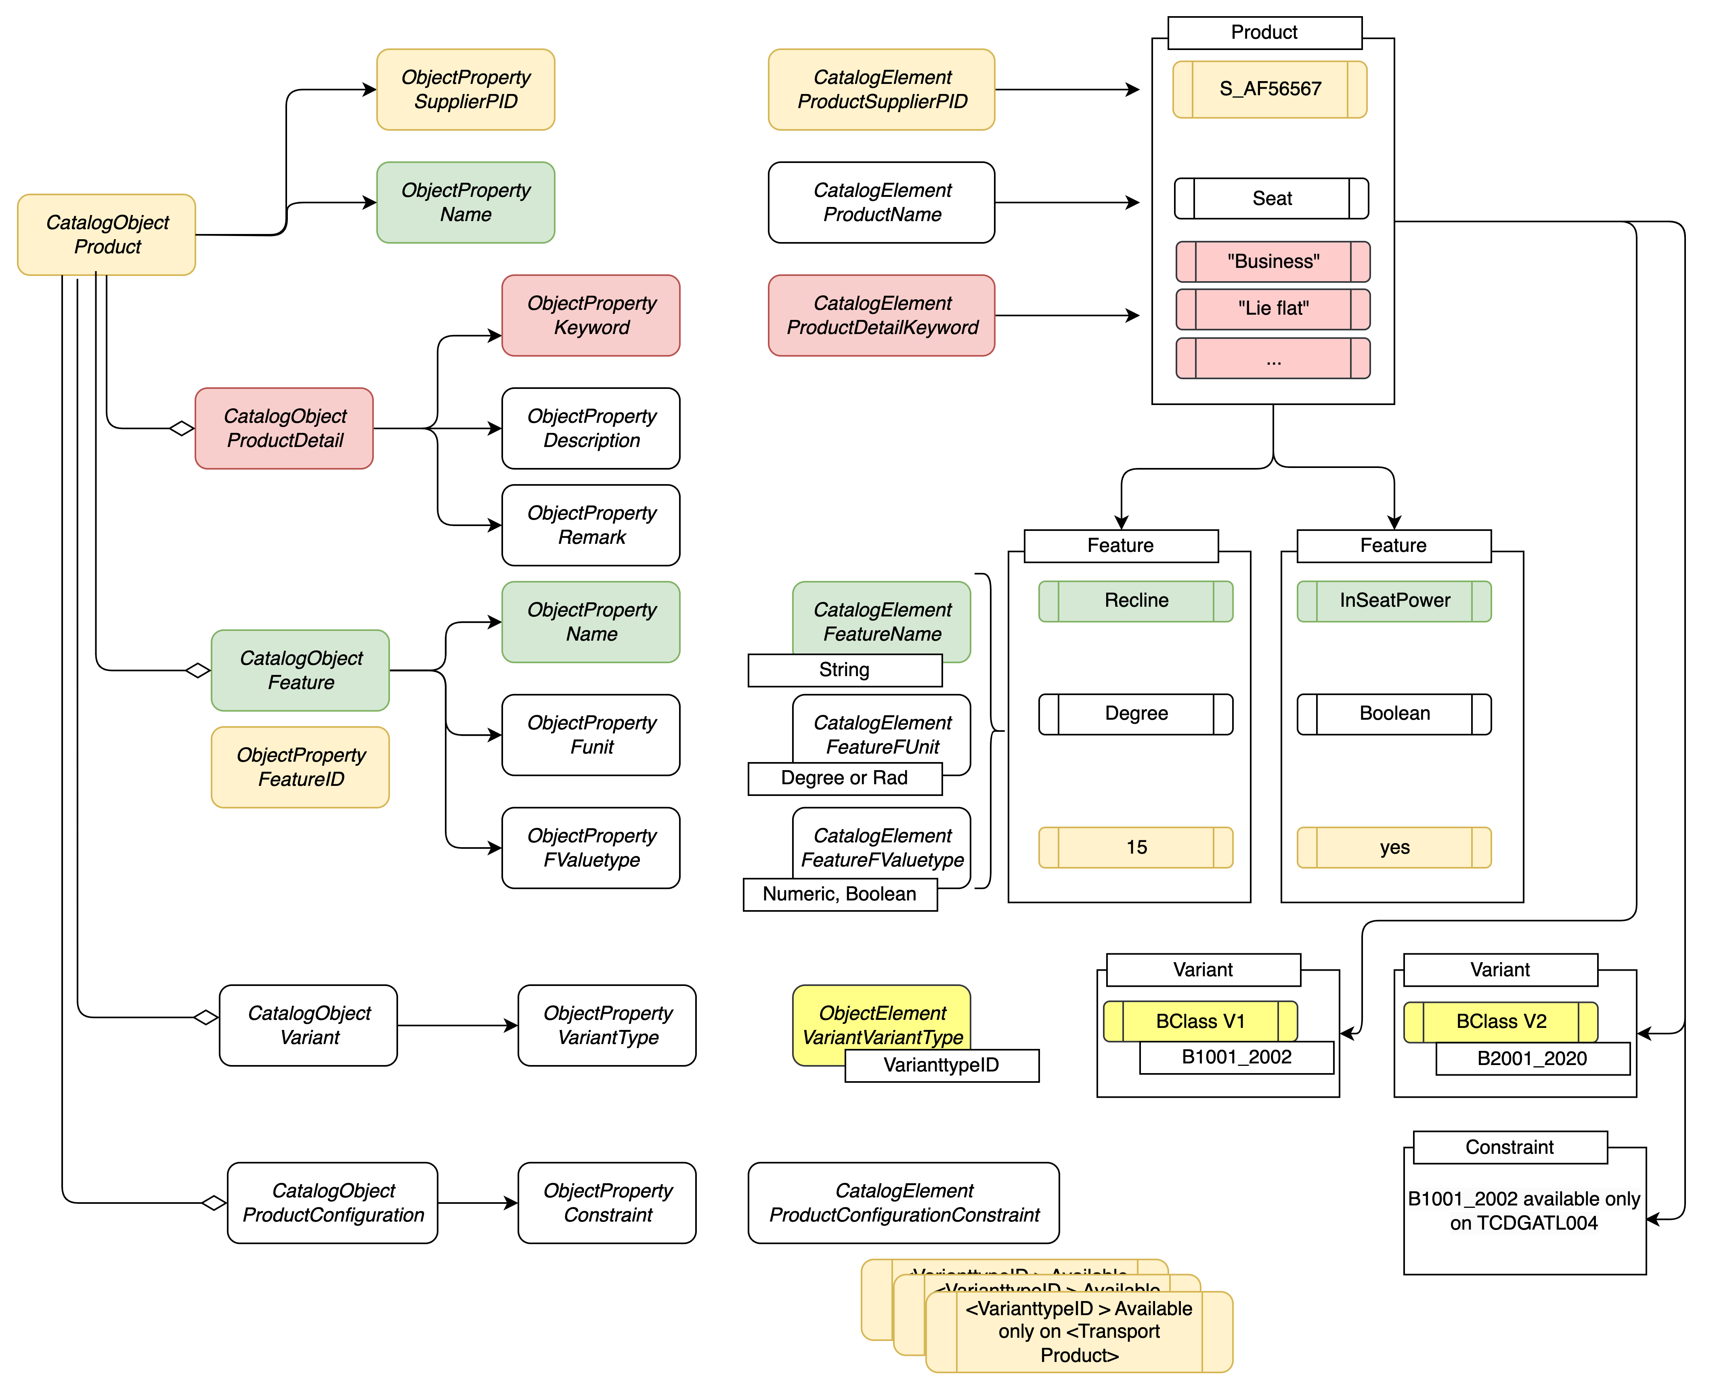
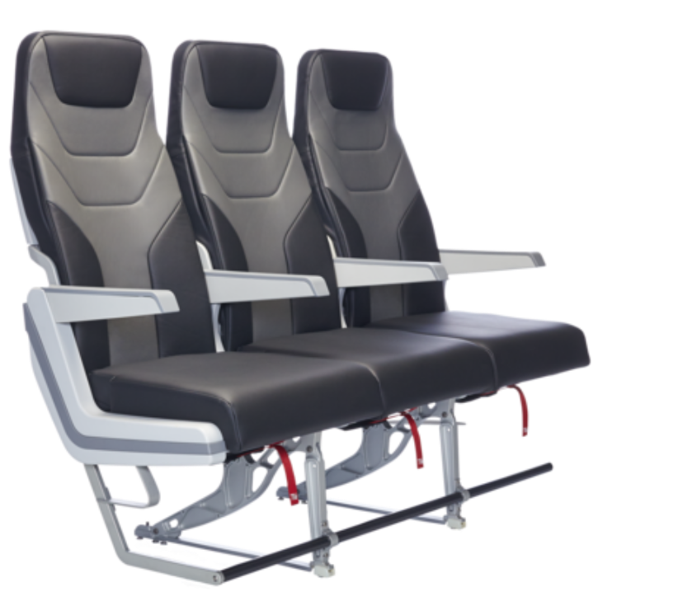

Slide 17
Attention Points
Complex
Reinvent
Lock-in
The devil lies in the detail and besides the meta model every single product needs attention to be properly specified on
A common denominator of features (as maybe industry-wide base products )
Bilateral configuration of equivalencies ( static and/or dynamic )
This type of structure / content is already used in many industries and standards are available.
Are we so different that we need to specify yet another standard for the Sender/Receiver Interface for product information ? (cf. slide 9)
The overall exchange will only work if we have a clear vision / manage the the first two points. Its worthwhile to avoid that the industry standard will be set a one/some vendors and is not under industry control with all the consequences that incurs.

Slide 18
Available eBusiness Standards
Identification Standards
Clearly identify Companies and Products
DUNS, GTIN, GRAI/GIAI, ILN/GLN,
NVE/SSCC, PZN, UPIK
Source: PimCORE
Classification Standards
Describe products consistently
ECLASS, ETIM, GPC, UNSPCS, IATA APMWG
Catalog Exchange Format
Provide product data electronically
BMEcat, cXML, Datanorm, PRICAT, xCBL, IATA APMWG
Transaction Standards
Exchange business documents automatically
EANCOM, GS1 XML, openTrans
Process Standards
Automate complex business processes
ECR, ebXML, RosettaNet, SCOR

Slide 19
Proposal
Ask
& Learn
Discuss with standardization specialists on this.
Run some inspiration sessions with e.g. ETIM, BMECat, GS1, ISO etc..
Learn and better grasp the do’s / don’ts in this area
Check/Improve on our requirements
Don’t reinvent the wheel if not necessary
Avoid running down dead-end roads

Slide 20
Business Stories
Requirement Interaction patterns EventDriven CDN as well as or P2P integration
New table
As an/a <Role> | I want | so that | Theme
Airline - Retailer | the latest up to date detailed product information available from my suppliers ( shape / form / conditions / ... full list to be determined ) | I can propose the most relevant and accurate offers to my customers | #UX #Inspiration #Acquisition #Existing products #Supplier Information
Airline - Retailer | to propose the best shopping experience to my customers | Customers can easily find detailed product information about each product, including specifications, features, and benefits. This can help anyone to make an informed purchasing decision. | #UX #Availability #Localization Of Information #Details available
Customer | to do easy multi criteria search based shopping. Text based search would be perfect | I get the most relevant offers rapidly | #UX #Full Text Search #AI Support #Adequate
Airline - Retailer | Up to date information about product delivery for orders i placed with my supplier | I can react accordingly in case of issues with the delivery | #Servicing #Repair #Aftersales #Event driven products #Supplier Information
Airline - Retailer | to be able to transparently exchange product configuration information with the supplier and vice versa | to honor specific agreement / products as define in the mutual agreements | #New products #Extensibility
Airline - Retailer | to be in control of the information provided by a supplier catalog | only the important / pertinent information is present for creating offers thus optimizing my ressource consumption | #Extensibility #Optional/Mandatory #Schema/Repository / management # Standardized Product Information #Lazy Loading
Airline - Supplier | to be able / to provide the most up to date and complete product information to my retailers within a bilaterally scope ( but can be public as well ) | the call rate for offers will be optimized and therefore the conversion rate shall increase | #Traffic #Conversion #Rate of updates #Event driven
Seller | to be able to compare the offers and products | I can show my customers most relevant offers with respect to my customers profile. | #Standardized Product Information #Compare products #Offer numbers returned #Performance
Notes:
Last line: Seller has only AirlineProfiles i.e. O&D or do they get more than O&D
Possibility to ship full product info with an offer
Retailer / supplier with shared product catalog we need to ship only references in the REQ and get the offer for that Req

Slide 21
Business Stories
Requirement Interaction patterns EventDriven CDN as well as or P2P integration
As an/a <Role> | I want | so that | Theme
Airline - Retailer | to receive the products that I can pay with a certain payment method from my suppliers. | I can show my customers only the payment methods they requested or the payment methods that I support. | #UX #Payment Information
Airline - Supplier | to update the routes that I operate or plan to operate | I can manage the traffic and keep my retailers up to date (frequency ?) | #Network #Schedule #Event driven #Update Management #Incremental
Airline - Retailer | to understand how the customer can reach the product for offers that I placed with my supplier | I can explain whether the customer should do something to reach the product. ( for instance, Create a membership, Use an app, for intermodal connections walk 10min or distance is 1km, can be reached by wheelchair) | #Operational/Delivery Product Information #Conditions (needs a bit more info )
Airline - Supplier | to be able to offer all possible products and services to any retailer I want (airline, OTA, TA, Corporate...) | I can expose any part of my product catalogue if I want to. | #Private #Public #Accessibility #Scope
Airline - Supplier | to be able to decommission a service anytime and all potential partners are notified | no order request can be placed for products/services that seized existing. | #Event driven #Realtime
Airline – Retailer or Supplier | to be able to offer/sell products/services that are for public offer thru available payment options | I can offer my customers/products a wide range of offers/offer my products to a wide range of customers | #Payment Information
Customer | to book a series of the between 5 to 10 cheapest possible flights to book a series of comfort flights carrying a bag and preorder my meal | I can fly around the world from GVA to GVA | #Network #Attribute shopping
Airline – Retailer or Supplier | I want to minimize number of “waste” offers/offer items for too generic shopping request when customer already knows what specific product(s) to ask for As many as possivble search attributes availbale to the customer | I keep transaction cost under control. The incomming requests are of the best possible quality yieling results the customer is most likely to accept | #Performance #Licensing #Cost Models #Operating Models #Request for Offer #Attribute shopping ( be more precise )
New table
Notes:
Payment details / as supplier I send a settlement value
Payment options as optional element attached to product
Inspirational shopping make the conditions ( app, membership etc ) visible here
Public : it’s a decision by the individual airline

Slide 22
Business Stories
Requirement Interaction patterns EventDriven CDN as well as or P2P integration
New table
As an/a <Role> | I want | so that | Theme
Airline - Retailer | to communicate a consistent product offering | the end-to-end journey makes sense and is easy for the customer | #Compare products #Common meaning of products
Airline - Retailer | to offer refundable business class(?) if supplier has refundable business class, and nonrefundable otherwise. |  | #Product/Offer levels ( branded fares ?) #Conditions
Customer | I want to get a flight from A to C in first class with WiFi, fast track, seat assignment, 5-course dinner, and 3 bags and maybe some other amenities (offer is presented with two airlines, retailer plus the supplier for the retailer ) | <intention> | #Attribute shopping #Product/Offer levels ( branded fares ?)
Notes:
Add levels of auality to the attributes / products

Slide 23

Themes Capabilities / Requirements
Add frequency to the word
#Compare products
#Common meaning of products
#Product/Offer levels
#Conditions
#Attribute shopping
#UX
#Payment Information
#Network ( Container)
Transport product : A to B ( Content )
#Schedule
#Event driven ( Management/processing)
#Update Management
#Operational/Delivery Product Information
#Conditions
#Product Attribute Quality Levels (Content)
#Private
#Public
#Accessibility
#Scope
#Realtime ( Management / Processing )
#Performance
#Licensing
#Cost Models
#Operating Models
#Request for Offer structure

Slide 24

Product & Catalog definitions Capabilities / Requirements
Add frequency to the word
ProductCatalog (PC) for Airline
SupplierCatalog (SP) for Supplier_{i}
Trade off between details in the catalog vs payload

